Slide 1



Incremental Graph Pattern Matching
Wenfei Fan Xin Wang Yinghui Wu
University of Edinburgh
Jianzhong Li Jizhou Luo
Harbin Institute of Technology
Zijing Tan
Fudan University

Slide 2
Outline
Graph pattern matching in real-life scenario
  graph pattern matching is expensive
  Real life graphs are changing over time
Incremental graph pattern matching
  Simulation, bounded simulation and subgraph isomorphism
  Incrementally computes changes to the match results
Incremental simulation
Incremental bounded simulation
Incremental subgraph isomorphism
Conclusion
Incremental solutions based on (extended) graph pattern matching
Notes:
Sometimes you use “edge to path”, and sometimes “edge-to-path”, better to uniform them

Slide 3
Real Life Graph Pattern Matching
Given a pattern M(Gp, G) graph (a query) Gp and a data graph G , to find the set of matches in G for Gp
usually in terms of …
  subgraph isomorphism (proximity search, biology and chemistry network querying, object identification)
  graph simulation (social querying, program verification)
  bounded simulation (social matching, semantic network)
How to define?
A routine process in real life applications
Notes:
Nan Tang: in the takeaway message, I won’t use two “application” s, you can use “Wide employed, used, etc”

Slide 4



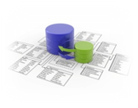







Example: querying FriendFeed
Ann, CTO
Dan, DB
Mat, Bio
Bill, Bio
Tom, Bio
Pat, DB
Don, CTO
Ross, Med
*
Ann, CTO
(bounded) simulation
edge-path relation
Ann, CTO
Dan, DB
1
subgraph isomorphism
edge-edge bijection
2
1
Bill, Bio
Subgraph isomorphism, simulation and bounded simulation
P
P
Pat, DB
Pat, DB
Bill, Bio
Mat, Bio
Notes:
Nan Tang: in the takeaway message, I won’t use two “application” s, you can use “Wide employed, used, etc”

Slide 5


Batch algorithm vs. Incremental algorithm
Graph pattern matching is expensive!
  NP-complete for subgraph isomorphism
  cubic-time for bounded simulation
  quadratic-time for simulation
Incremental graph pattern matching
Typically small (5%/week in Web graphs)
P
G
M(Gp,G)
How to measure complexity?
∆G
∆M
P
G⊕∆G
M(Gp,G)⊕∆M
Computes new matches from old matches!
<#>

Slide 6

Complexity of incremental algorithms
Result graphs
  Union of isomorphic subgraphs for subgraph isomorphism
  A graph Gr = (Vr, Er) for (bounded) simulation
    Vr : the nodes in G matching pattern nodes in Gp
    Er: the paths in G matching edges in Gp
Affected Area (AFF)
  the difference between Gr and Gr’, the result graph of Gp in G and G⊕∆G, respectively.
  |CHANGED| = |∆G| + |AFF|
Optimal, bounded and unbounded problem
  expressible by f(|CHANGED|)?
*
Ann, CTO
1
(bounded) simulation
edge-path relation
Ann, CTO
Dan, DB
subgraph isomorphism
2
1
Bill, Bio
P
P
Pat, DB
Pat, DB
Bill, Bio
Mat, Bio
Measure the complexity with the size of changes
<#>

Slide 7
Complexity of incremental algorithms (cont)
Insert e2
Insert e1
Ann, CTO
Dan, DB
Mat, Bio
e5
Insert e3
e3
Bill, Bio
Tom, Bio
e4
Insert e4
e2
Insert e5
Pat, DB
Don, CTO
Ross, Med
e1
∆G
G
P
Gr
Ann, CTO
Don, CTO
*
CTO
affected area
2
1
Pat, DB
Dan, DB
DB
1
Bio
Bill, Bio
Tom, Bio
Mat, Bio
<#>

Slide 8
Incremental Simulation matching
Problem statement
  Input: Gp, G, Gr, ∆G
  Output: ∆Gr, the updates to Gr s.t. Msim(G⊕∆G) = M(Gp,G)⊕∆M
Complexity
  unbounded even for unit updates and general patterns
  bounded for single-edge deletions and general patterns
  bounded for single-edge insertions and DAG patterns, within optimal time O(|AFF|)
  In O(|∆G|(|Gp||AFF| + |AFF|²)) for batch updates and general patterns
Measure the complexity with the size of changes
<#>

Slide 9
Incremental Simulation matching: optimal results
-
unit deletions and general patterns: Algorithm IncMatch
delete e6
Ann, CTO
Dan, DB
1. identify s-s edges
Mat, Bio
2. find invalid match
Bill, Bio
e6
3. propagate affected
Area and refine matches
Pat, DB
Don, CTO
G
P
Gr
Ann, CTO
affected area / ∆Gr
CTO
Pat, DB
Dan, DB
DB
e6
optimal with the size of changes
Bio
Bill, Bio
Mat, Bio
<#>

Slide 10
Incremental Simulation matching: optimal results
+
unit insertion and DAG patterns: Algorithm IncMatch
insert e7
Ann, CTO
Dan, DB
identify cs and
cc edges
Mat, Bio
2. find new valid matches
Bill, Bio
e7
3. propagate affected
Area and refine matches
Pat, DB
Don, CTO
G
P
Gr
Ann, CTO
candidate
CTO
Dan, DB
Pat, DB
DB
e7
e7
optimal with the size of changes
Bio
Bill, Bio
Mat, Bio
<#>
Linear time wrt. the size of changes

Slide 11
Incremental Simulation matching: optimal results
Batch updates: Algorithm IncMatch
insert e7
Ann, CTO
Dan, DB
identify cs and
cc edges
Mat, Bio
2. find new valid matches
Bill, Bio
e7
3. propagate affected
Area and refine matches
Pat, DB
Don, CTO
G
P
Gr
Ann, CTO
candidate
CTO
Dan, DB
Pat, DB
DB
e7
e7
optimal with the size of changes
Bio
Bill, Bio
Mat, Bio
<#>
Linear time wrt. the size of changes

Slide 12
Incremental bounded graph Simulation
Problem statement
  Input: Gp, G, Gr, ∆G
  Output: ∆Gr, the updates to Gr s.t.
  Mbsim(G⊕∆G) = M(Gp,G)⊕∆M
Complexity
  unbounded even for unit updates and path patterns
  In O(|∆G|(|AFF|log|AFF| + |Gp||AFF| + |AFF|²)) for batch updates and general patterns
Measure the complexity with the size of changes
<#>

Slide 13
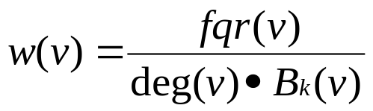
Incremental bounded graph simulation
Weighted landmark vectors
  A list of nodes L in a graph G, s.t for each pair (u,v) of nodes in G, there is an node in L on a shortest path from u to v
  Answering distance query: linear time
  Weights on landmark:
“high quality” : not changed frequently
2
3
…
Dan, DB
Ann, CTO
2
…
4
Mat, Bio
lm₁
lm₂
…
lmi
…
lmk
Bill, Bio
Tom, Bio
4
1
…
1
…
4
Pat, DB
Don, CTO
G
A landmark vector LM

Slide 14
Incremental bounded graph Simulation
Unit updates
  cc, cs, ss pairs
  Only the cs / cc pairs (resp. ss) with updated distances satisfying (resp. not satisfying) the bound of a pattern edge may affect the matching result
A two-step strategy for incremental bounded simulation
  Identify all cc, cs, (ss) pairs via a landmark vector
  find changes ∆M to matches, by treating cc, cs (ss) as insertions of the edges to Gr (deletions from Gr)
“reducing” bounded simulation in G to simulation in Gr
<#>

Slide 15
Incremental bounded Simulation matching
+
unit insertion and general patterns: Algorithm IncBMatch
Step 1: identify cc and cs pairs
P
*
CTO
…
Step 2: find the changes to match by inserting edge (Don, Tom) in Gr and propagating changes
2
Ann, CTO
1
…
DB
1
Pat, DB
Bio
e2
Don, CTO
Gr
Ann, CTO
Don, CTO
Gr
Tom, Bio
Pat, DB
Dan, DB
…
Dan, DB
Ann, CTO
Mat, Bio
Bill, Bio
Tom, Bio
Mat, Bio
Pat, DB
<#>
unit deletion is similarly processed as unit insertion

Slide 16
Incremental subgraph isomorphism
Incremental subgraph isomorphism matching:
  Input: Gp, G, Gr, ∆G
  Output: ∆Gr, the updates to Gr s.t.
  Miso(G⊕∆G) = M_{iso}(Gp,G)⊕∆M
Incremental subgraph isomorphism:
  Input: Gp, G, Gr, ∆G
  Output: true if there is a subgraph in G⊕∆G that is isomorphi
  = M_{iso}(Gp,G)⊕∆M
Complexity
  IncIsoMatch is unbounded even for unit updates over DAG graphs for path patterns
  IncIso is NP-complete even for path pattern and unit update
<#>

Slide 17
Experimental evaluation
Experimental setting
  Youtube network, with 187K nodes and 1M edges,. We use snapshots each of 18K nodes and 48K edges.
  Citation network, with 630K nodes and 633K edges. We use snapshots each of 18K nodes and 62K edges.
  Synthetic data, with randomly generated updates.
  Pattern generator, controlled by the number of nodes, edges, predicates and bounds on edges.
Problem | Batch | Incremental
IncSim | Match_{s} | IncMatch,IncMatch_{n}, HORNSAT
IncBSim | Match_{bs} | IncBMatch, IncBMatch_{m}
IncIsoMat | VF2 | IncIsoMatch,IsoUMatch
Optimizations | BatchLM,minDelta | InsLM

Slide 18

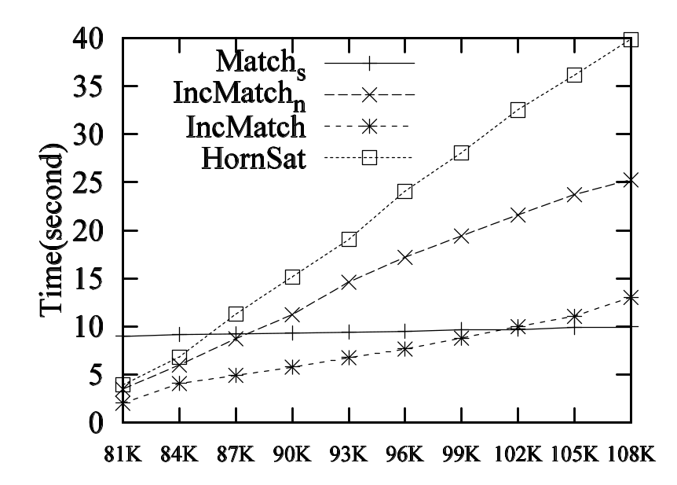
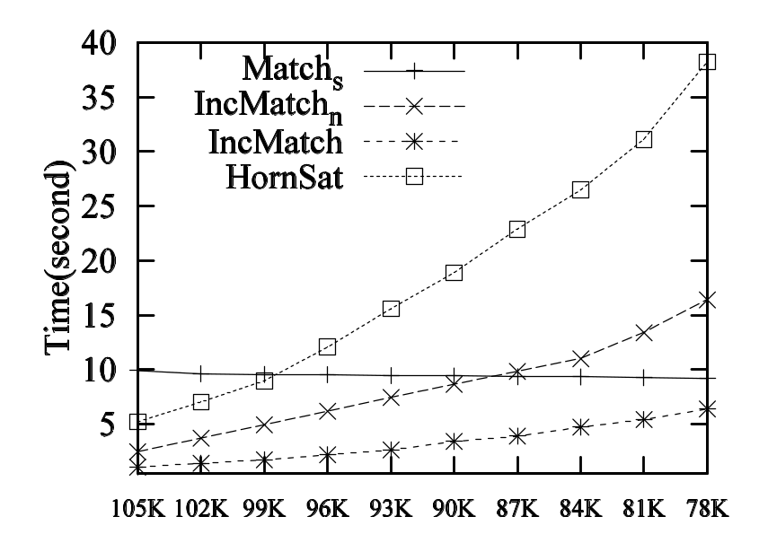
Experimental results:incremental graph simulation
30% - 40%I changes
30% - 40% changes
Inserting edges
removing edges
Incremental simulations improve batch algorithms by over 40%-50%

Slide 19
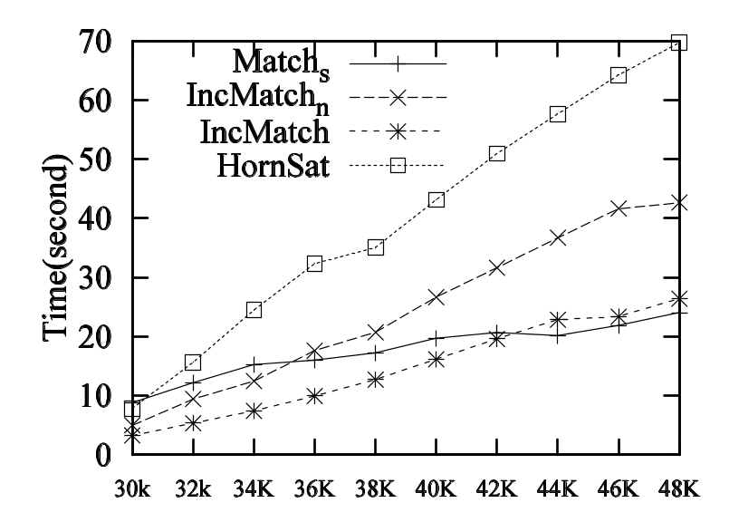
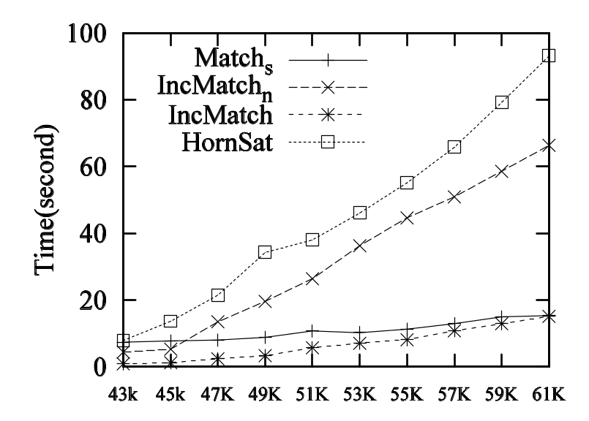
Experimental results:incremental graph simulation
30% - 40%I changes
More than 50% changes
Inserting edges over Youtube
Inserting edges over Citation
Incremental simulations improve batch algorithms by over 40%-50%

Slide 20
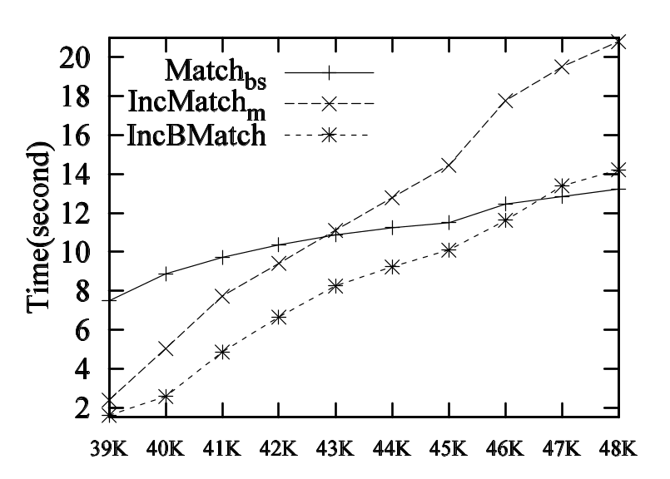
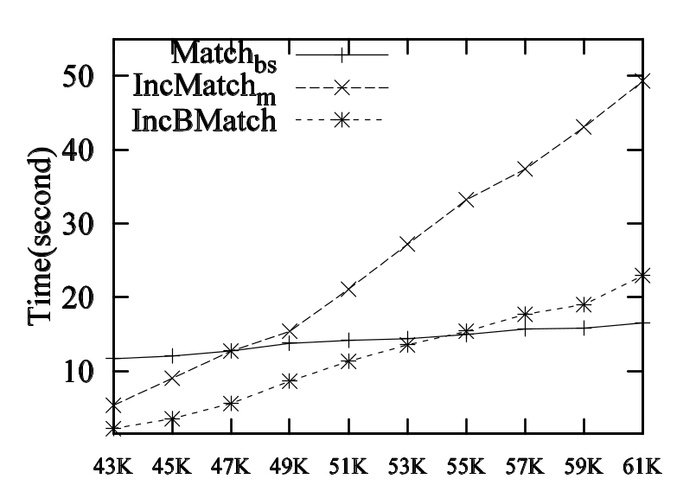
Experimental results: incremental bounded simulation
20% changes
Inserting edges over Youtube
Inserting edges over Citation
Incremental bounded matching improved batch ones by over 50% - 60%

Slide 21
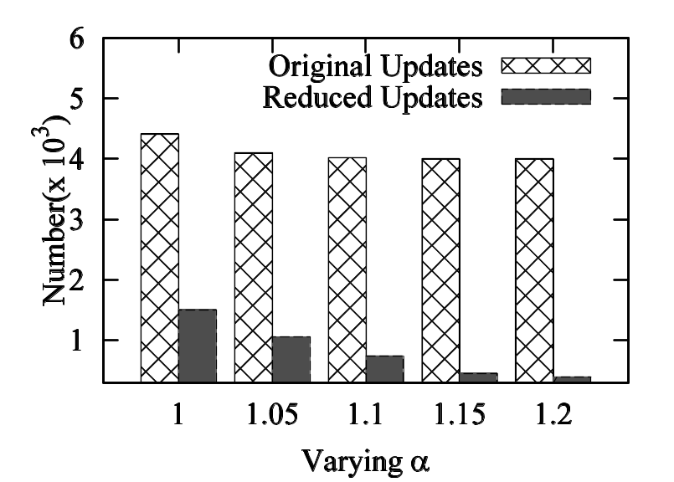
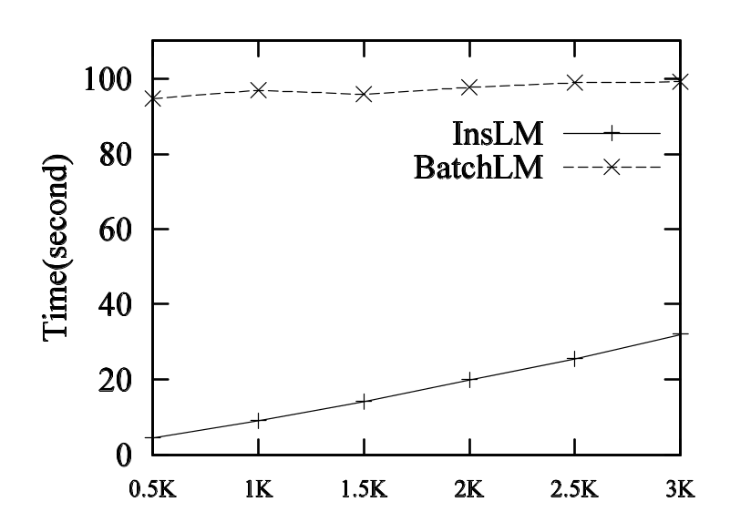
Experimental results: incremental subgraph matching, and optimizations
Effectiveness of reducing redundant updates and maintaining landmarks

Slide 22
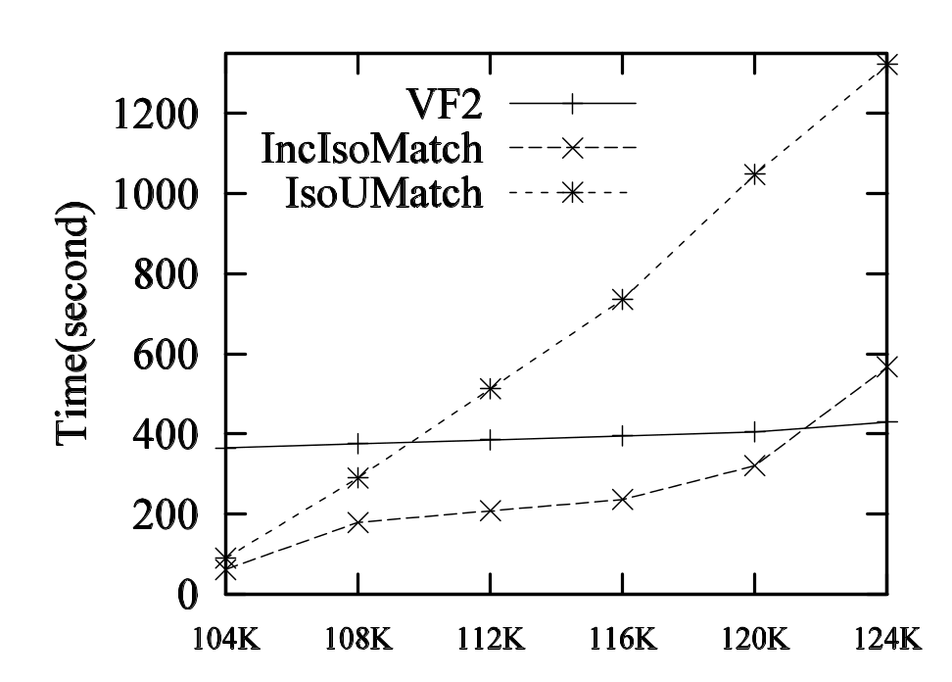
Experimental results: incremental subgraph isomorphism
Inserting edges
IncIsoMatch outperforms VF2 when the changes are no more than 20%

Slide 23
Conclusion
Incremental solutions for graph pattern matching
  Incremental graph pattern matching
    Incremental simulation
    Incremental bounded simulation
    Incremental subgraph matching
  Algorithms for each of these problems
Measure complexity with size of changes
Problem | Complexity | Incremental
IncSim | Unbounded Bounded for unit deletion/ unit insertion and DAG patterns | IncMatch
IncBSim | Unbounded | IncBMatch
IncIsoMat | Unbounded NP-complete | IncIsoMatch,IsoUMatch
Incremental graph pattern matching

Slide 24

Future work
Larger datasets with various applications
Optimization techniques from exploring real-life user patterns?
Bounded incremental heuristic algorithms for subgraph isomorphism
Incremental graph matching over distributed graph data
Incremental graph pattern matching
Notes:
Another issue might be the space cost from landmark vectors.

Slide 25


Incremental graph pattern matching
Thank you!

Slide 26
Subgraph isomorphism and Graph Simulation
Node label equivalence
Edge-to-edge function/relation
A
A
E
D
E
D
B
B
B
v₁
v₂
B
B
B
D
E
D
E
A
A
P
G
P
G
Capable enough?
Identical label matching, edge-to-edge function/relations

